Slide 1


Car Price Prediction using Machine Learning
Predicting car prices accurately is a crucial aspect of the automotive market, benefiting both buyers and sellers. This project leverages the power of machine learning, specifically the Random Forest algorithm, to develop a robust and precise car price prediction model. By analyzing historical car data and employing hyperparameter tuning, we aim to create a model that outperforms traditional pricing methods and provides valuable insights into the factors influencing car values. This presentation will delve into the project's methodology, results, and potential future enhancements.
by Dhanur Mudgal

Slide 2
Abstract
This project aims to predict car prices using a comprehensive dataset of car features and advanced machine learning techniques. The dataset includes various attributes such as make, model, year, mileage, condition, and other relevant factors. Our goal is to develop a model that accurately predicts the market value of a used car, empowering both buyers and sellers with data-driven insights. We utilize the Random Forest regression algorithm, known for its ability to handle complex datasets and capture non-linear relationships. Furthermore, we employ feature importance analysis to understand the key drivers of car prices and RandomizedSearchCV for hyperparameter tuning to optimize the model's performance and achieve the highest possible prediction accuracy.
1
Dataset
2
Goal
3
Approach
Comprehensive historical car data with features like make, model, year, mileage, and condition.
Accurate prediction of used car market values for informed decision-making by buyers and sellers.
Random Forest regression, feature importance analysis, and RandomizedSearchCV for hyperparameter tuning.

Slide 3
Introduction
In today's dynamic used car market, accurate pricing is paramount. Sellers need to price competitively to attract buyers, while buyers seek fair valuations to avoid overpaying. Traditional pricing methods often rely on subjective assessments and outdated information, leading to inconsistencies and potential disputes. Machine learning offers a powerful solution to this challenge, enabling data-driven predictions based on a multitude of factors. Random Forest, an ensemble learning method, is particularly well-suited for this task due to its ability to handle both numerical and categorical data, capture complex relationships, and provide insights into feature importance. This allows for a more nuanced and precise prediction compared to simpler linear models.
The Problem
Machine Learning
Random Forest
Inaccurate car pricing in the used car market affects both buyers and sellers.
Offers data-driven solutions for accurate price predictions based on multiple features.
A suitable algorithm for handling complex datasets and non-linear relationships in car pricing.

Slide 4
Existing Problem
Manual car pricing methods are often plagued by subjectivity, leading to significant price discrepancies and inefficiencies in the used car market. Dealerships and individual sellers may rely on limited information, personal experience, or rule-of-thumb estimations, resulting in prices that don't accurately reflect a car's true market value. This can lead to frustration for buyers who may overpay or miss out on good deals, while sellers may struggle to sell their vehicles at a fair price. Automating the pricing process through a data-driven approach eliminates these challenges, providing transparency and consistency in car valuations.
Subjectivity
Limited Information
Manual pricing relies on individual judgment, leading to inconsistencies.
Decisions may be based on incomplete data, affecting price accuracy.
Inefficiency
Price Discrepancies
Manual pricing is time-consuming and prone to errors.
Significant variations in prices can create confusion and unfairness in the market.

Slide 5




Proposed Solution
Our proposed solution utilizes a machine learning model trained on a vast dataset of car features to predict prices accurately. This model employs the Random Forest algorithm, an ensemble method known for its robustness and ability to handle complex datasets. Feature importance analysis is conducted to identify the most influential factors affecting car prices, providing valuable insights into market dynamics. Hyperparameter tuning through RandomizedSearchCV further refines the model's performance, ensuring optimal accuracy and minimizing prediction errors. This data-driven approach provides a more objective and reliable method for car valuation compared to traditional manual methods.
Data Collection
Model Training
Hyperparameter Tuning
Price Prediction
Gather comprehensive historical car data with relevant features.
Train a Random Forest model on the preprocessed data.
Deploy the model to predict car prices accurately.
Optimize model parameters using RandomizedSearchCV.

Slide 6




Technologies Used
This project leverages the power of Python and its rich ecosystem of data science libraries. Pandas is used for data manipulation and cleaning, NumPy for numerical computations, and Scikit-learn for building and evaluating the machine learning model. Seaborn and Matplotlib are employed for creating insightful visualizations of the data and model performance. The Random Forest regressor and RandomizedSearchCV for hyperparameter tuning are implemented using Scikit-learn. Finally, the trained model is saved using Pickle for easy deployment and future use. This combination of tools provides a robust and efficient environment for developing a high-performing car price prediction model.
Python
Pandas
Scikit-learn
Visualization
Core programming language for data processing and model building.
Data manipulation and analysis library.
Machine learning library for model training and evaluation.
Seaborn and Matplotlib for data visualization.

Slide 7
Architectural Diagram
The project follows a clear and structured workflow. It begins with loading the raw data from a CSV file. The data then undergoes preprocessing, which includes handling missing values, converting categorical variables using one-hot encoding, and potentially creating new features like car age. The preprocessed data is then used to train the Random Forest model. Hyperparameter tuning is performed using RandomizedSearchCV to optimize the model's parameters. Finally, the trained model is evaluated using metrics like MAE, MSE, RMSE, and R-squared score, and then used to make predictions on new car data. This diagram visually represents the data flow and steps involved in building and deploying the car price prediction model.
1
2
3
4
Input Data (CSV)
Preprocessing
Model Training
Prediction
Raw data containing car features and prices is loaded.
Data cleaning, handling missing values, categorical variable encoding, and feature engineering.
Training the Random Forest model with optimized hyperparameters.
Generating car price predictions using the trained model.

Slide 8
Methodologies
The project methodology involves several key steps. First, data preprocessing is performed to clean and prepare the data for model training. This includes handling missing values, converting categorical features into numerical representations using one-hot encoding, and creating new features such as car age to enhance model accuracy. Next, a Random Forest model is trained on the preprocessed data. This model is chosen for its ability to handle complex relationships and various data types. Hyperparameter tuning is then performed using RandomizedSearchCV to find the optimal settings for the Random Forest algorithm, further improving its predictive power. Finally, the model's performance is evaluated using metrics like Mean Absolute Error (MAE), Mean Squared Error (MSE), Root Mean Squared Error (RMSE), and R-squared score.
Data Preprocessing
Handling missing values, one-hot encoding, feature engineering (car age)
Model Building
Random Forest Regressor
Hyperparameter Tuning
RandomizedSearchCV
Evaluation Metrics
MAE, MSE, RMSE, R² score

Slide 9
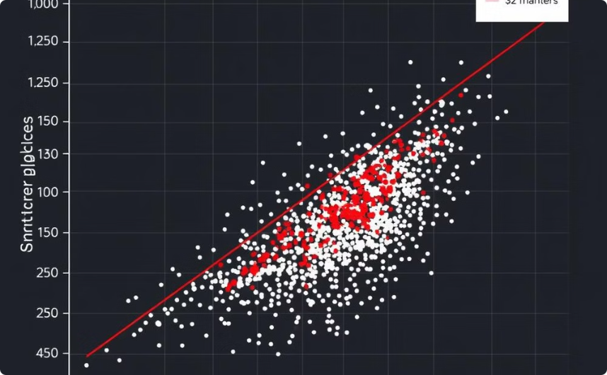
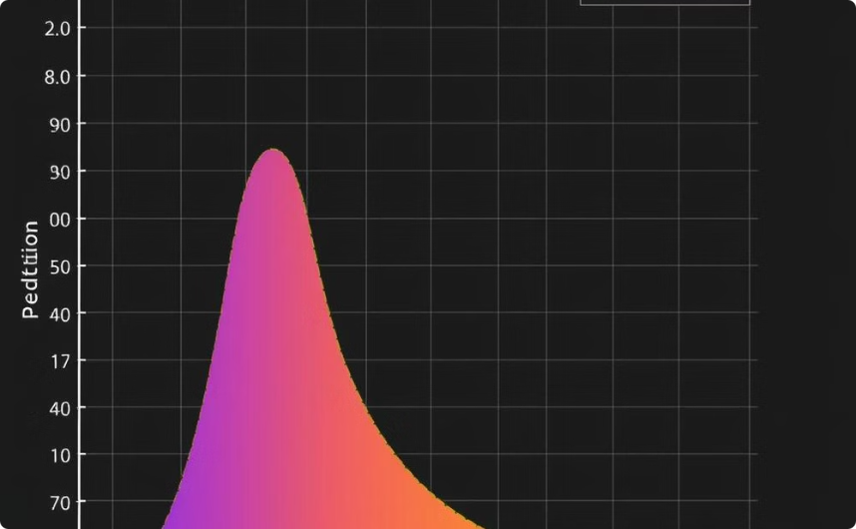
Results
The trained Random Forest model demonstrated strong performance in predicting car prices. An R-squared score of 0.95 indicates that the model explains 95% of the variance in car prices, suggesting a high level of accuracy. The RMSE value of 0.58 quantifies the average prediction error in the same units as the target variable (e.g., price). The MAE of 0.42 represents the average absolute difference between predicted and actual car prices. These results, combined with visualizations such as scatter plots and distribution plots of predicted versus actual prices, showcase the model's effectiveness in capturing the complex relationships within the car data and providing accurate price predictions.
Scatter Plot
Distribution Plot
Visualizes the relationship between predicted and actual prices.
Illustrates the distribution of prediction errors.

Slide 10
Conclusions
This project successfully developed a robust car price prediction model using the Random Forest algorithm and hyperparameter tuning. The model achieved high accuracy, as demonstrated by the R-squared score, RMSE, and MAE. This data-driven approach offers significant advantages over traditional manual pricing methods, providing more accurate and objective car valuations. Future work could involve exploring additional data sources, such as car history reports or market trends, to further enhance the model's predictive power. Experimenting with other machine learning algorithms, such as gradient boosting or neural networks, could also be explored to potentially improve performance. Continuous refinement and adaptation to changing market dynamics will ensure the model remains a valuable tool for car pricing.
1
Project Summary
2
Key Results
3
Future Work
Successful development of a high-accuracy car price prediction model using Random Forest.
High R-squared, low RMSE and MAE demonstrate the model's effectiveness.
Exploring additional data sources, experimenting with other algorithms, and continuous model refinement.

